Slide 1

TRB Paper Number: 17-01062
Session 384, Monday, January 9, 2017, 1:30 PM – 3:15 PM
Proactive Identification of Hazardous Traffic Conditions
Caused by Reduced Visibility
using Road Weather Information
Hyunjin Park *, Soyoung Jung *, Cheol Oh*
* Department of Transportation and Logistics Engineering, Hanyang University, Korea

Slide 2
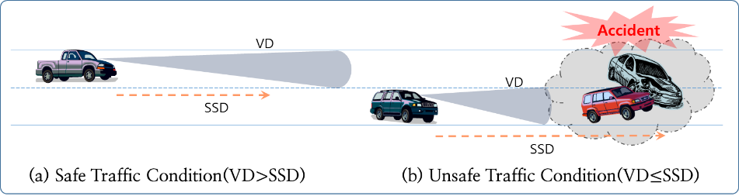
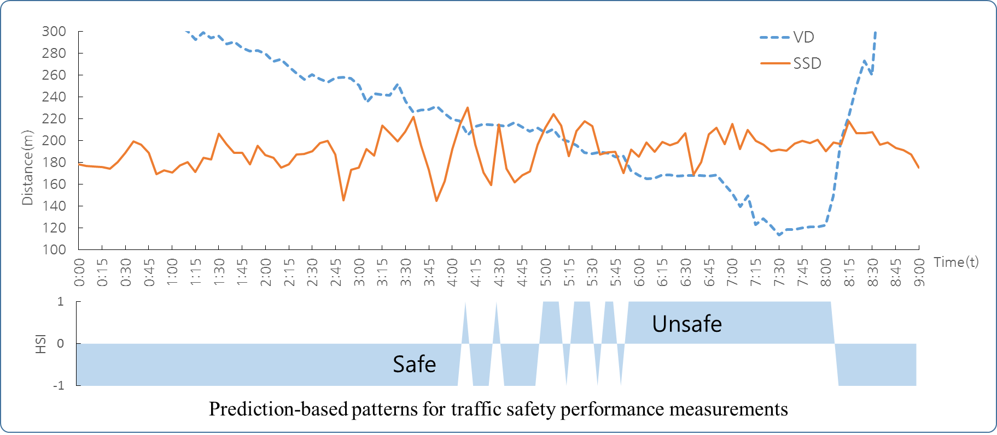
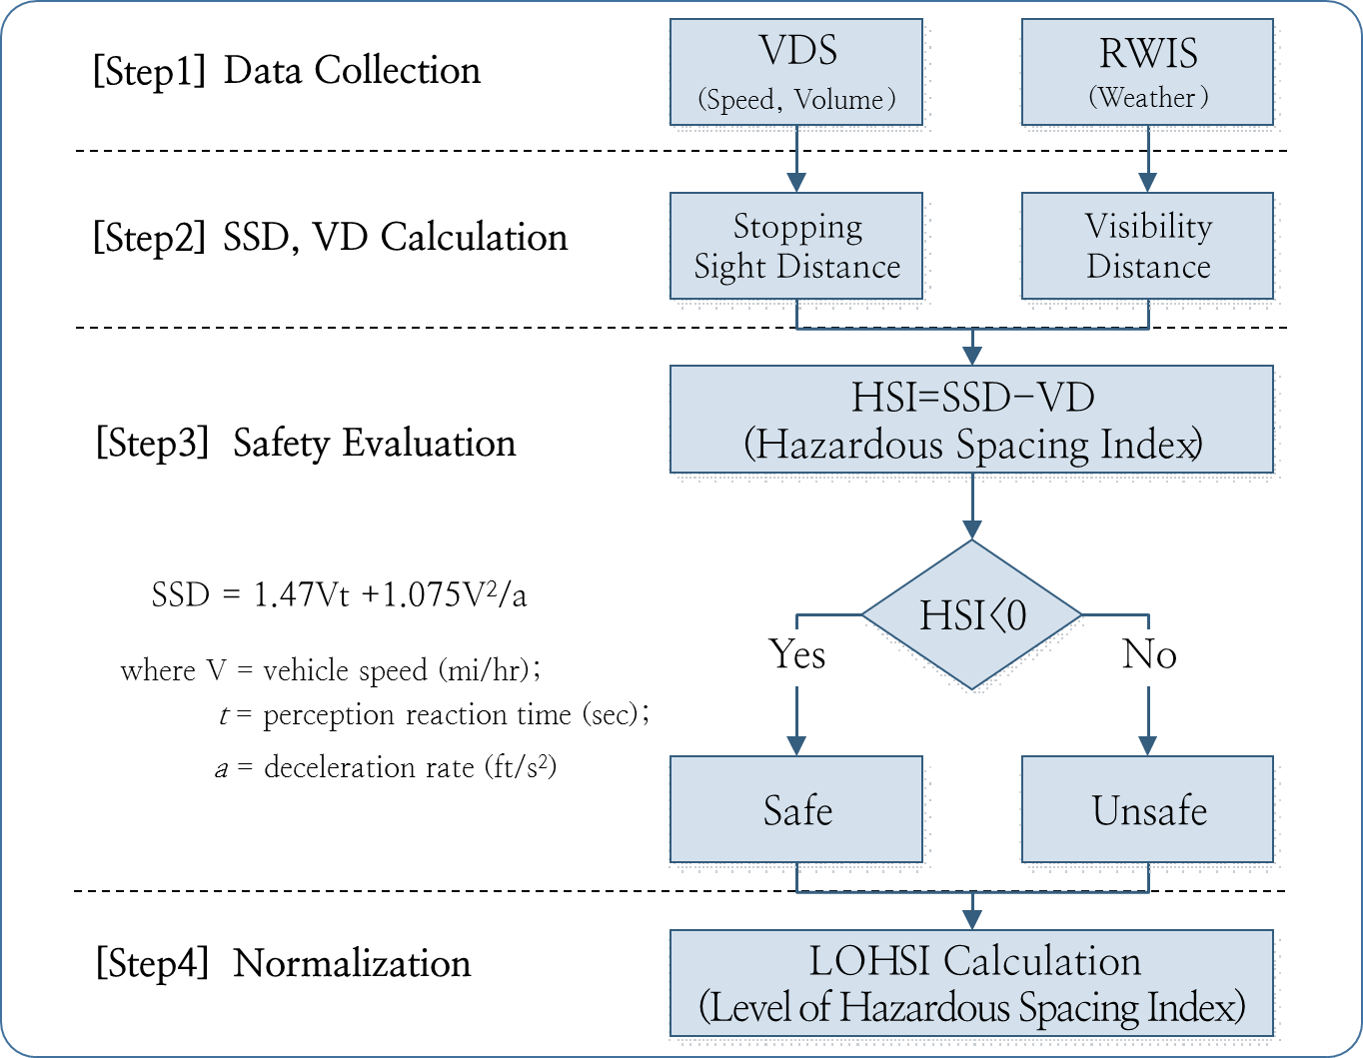
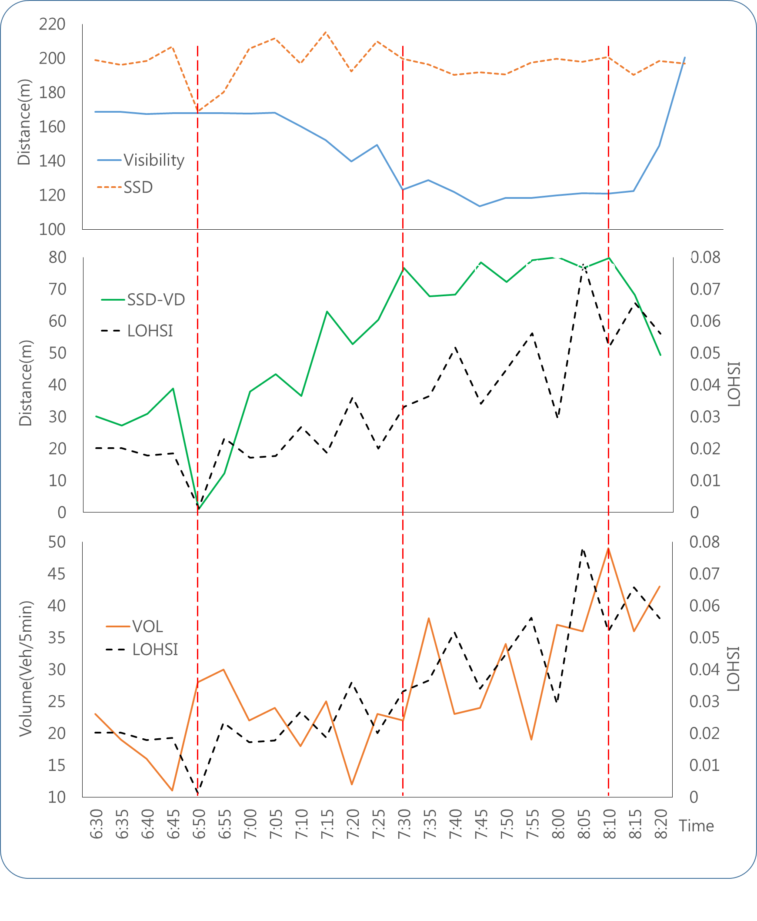
This study proposes a novel methodology to identify hazardous freeway traffic events based on the prediction of weather and traffic conditions.
$$LOHSI$$
= $\frac{HSI}{Exposure}$
= $\frac{\sum_{a=0}^{n}{(}{HSI}_{t+a}×q_{t+a})}{{n×(HSI×q)}_{max}×N_{l}}$
(0<LOSHI<1)

